Slide 1
UT Runtime/Systems PANDO Update

Slide 2
Outline
Background on Galois and Gluon
Update on runtime progress with Log-structured CSR
Compiler toolchain background and vision
Abelian
IrGL

Slide 3
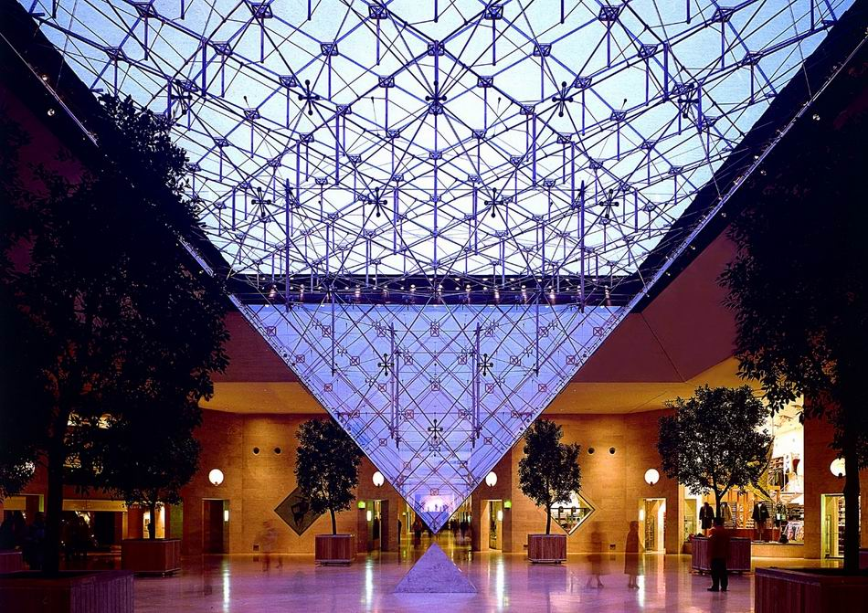
Galois system
Parallel program = Operator + Schedule + Parallel data structures
Ubiquitous parallelism:
small number of expert programmers must support large number of application programmers
cf. SQL
Galois system:
expert: library of concurrent data structures and runtime system
app: application code in sequential C++
Galois set iterator for highlighting opportunities for exploiting ADP
app: Operator + Schedule
expert: Parallel data structures
and runtime system

Slide 4
Hello graph Galois Program
#include “Galois/Galois.h”
#include “Galois/Graphs/LCGraph.h”
struct Data { int value; float f; };
typedef Galois::Graph::LC_CSR_Graph<Data,void> Graph;
typedef Galois::Graph::GraphNode Node;
Graph graph;
struct P {
void operator()(Node n, Galois::UserContext<Node>& ctx) {
graph.getData(n).value += 1;
}
};
int main(int argc, char** argv) {
graph.structureFromGraph(argv[1]);
Galois::for_each(graph.begin(), graph.end(), P());
return 0;
}
Data structure
Declarations
Operator
Galois Iterator

Slide 5
Parallel execution of Galois programs
Application program
Sequential C++
Galois set iterator: for each
New elements can be added to set during iteration
Optional scheduling specification (cf. OpenMP)
Highlights opportunities in program for exploiting amorphous data-parallelism
Runtime system
Ensures serializability of iterations
Execution strategies
Speculation
Interference graphs
Multicore CPU or GPU
Application Program
Master thread
main()
….
for each …..{
…….
…….
}
.....
i₁
i₃
i₂
i₄
Workset
of active nodes
i₅
Graph
Concurrent
data structures
Notes:
Consistency vs isolation

Slide 6
Distributed Graph Analytics
Applications:
Datasets: unstructured graphs
Pathfinding
Recommendations
Searching
Centrality / Importance
Need TBs of memory
Credits: yola,edutopiaglobal.com slideshare, amazon.com
Credits: Sentinel Visualizer
Notes:
Graph analytics:
1. random memory access
2. unpredictable control flow

Slide 7
Vertex Programming Model
Every node has a label
e.g., distance in single source shortest path (SSSP)
Apply an operator on an active node in the graph
e.g., relaxation operator in SSSP
Push-style: reads its label and writes to neighbors’ labels
Pull-style: reads neighbors’ labels and writes to its label
Termination: no more active nodes (or work)
Applications: breadth first search, connected component, k-core, pagerank, single source shortest path, betweenness centrality, etc.
R
W
push-style
R
W
pull-style

Slide 8
Distributed Galois using Gluon
Programmers:
Write Galois/IrGL applications
Interface with Gluon using API
Gluon transparently handles:
Graph partitioning
Communication and synchronization
GPU
IrGL
Gluon Plugin
CPU
Gluon Comm. Runtime
Galois
CPU
Gluon Plugin
Gluon Comm. Runtime
Gluon Comm. Runtime
CuSP Partitioner
CuSP Partitioner
Network (LCI/MPI)
Network (LCI/MPI)
Galois [SoSP’13]
IrGL [OOPSLA’16]
LCI [IPDPS’18]
CuSP [IPDPS’19]
Notes:
Host-to-device and inter-host communication
API and plugin

Slide 9
Partitioning
Host h1
Host h2
B
C
A
D
F
G
E
H
I
J
Original graph
Partitions of the graph

Slide 10
Partitioning
Host h1
Host h2
Each edge is assigned to a unique host
B
C
A
D
F
G
E
H
I
J
Original graph
Partitions of the graph

Slide 11
Partitioning
Host h1
Host h2
Each edge is assigned to a unique host
All edges connect proxy nodes on the same host
B
C
B
C
B
C
D
A
D
A
F
G
F
G
F
G
E
H
E
H
I
J
I
J
J
Original graph
Partitions of the graph

Slide 12
Partitioning
Host h1
Host h2
Each edge is assigned to a unique host
All edges connect proxy nodes on the same host
A node can have multiple proxies: one is master proxy; rest are mirror proxies
B
C
B
C
B
C
D
A
D
A
F
G
F
G
F
G
E
H
E
H
I
J
I
J
J
: Master proxy
: Mirror proxy
Original graph
Partitions of the graph

Slide 13
How does Gluon synchronize the proxies?
Exploit domain knowledge
Cached copies can be stale as long as they are eventually synchronized
Host h1
Host h2
1
8
B
C
B
C
0
A
8
D
F
G
F
G
1
8
E
8
H
I
J
J
: Master proxy
: Mirror proxy
: distance (label) from source A

Slide 14
How does Gluon synchronize the proxies?
Exploit domain knowledge
Cached copies can be stale as long as they are eventually synchronized
Use all-reduce:
Reduce: mirror proxies to master proxy
Broadcast: master to mirror proxies
Host h1
Host h2
1
B
C
B
C
0
8
A
1
D
F
G
F
G
1
1
E
8
H
I
J
J
: Master proxy
: Mirror proxy
: distance (label) from source A

Slide 15
Gluon Distributed Execution Model
Host h1
Host h2
Gluon partitioner
Gluon partitioner
Galois/CPU IrGL/CUDA on GPU
Galois/CPU
IrGL/CUDA on GPU
Gluon comm. runtime
MPI/LCI
MPI/LCI
Gluon comm. runtime
Galois [SoSP’13]
Ligra [PPoPP’13]
IrGL [OOPSLA’16]
LCI [IPDPS’18]

Slide 16
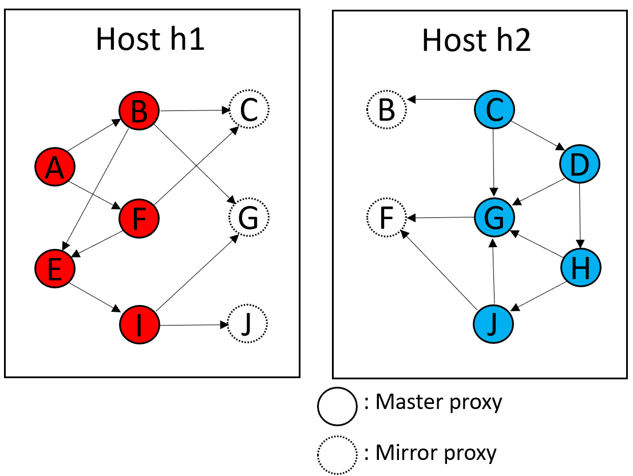
Key Research Question
Do we need overlapping partitions for PANDO?
PGAS address space
Hide latency with Massive MT
Proxies will still have benefit:
Locality → lower latency
Batched communication
Are the benefits worth it?
Performance modeling to the rescue?

Slide 17
Log Structured CSR
Key ideas
CSR: great read performance, poor write performance
Log-structure →
preserves read locality for evolving CSR
Append-only writes → better write performance
Key questions
Representation for topology
Representation for properties
Synchronization design

Slide 18
Background: LPGs
Labeled property graphs
TBD
Notes:
Add text for what is what; add animations if time

Slide 19
Background: CSR
CSR is an efficient way to represent sparse graphs
But not efficiently updateable
Represents topology only
Compressed Sparse Row
Vertex Array
Edge Array
Goals:
Increase cache-ability of graph
Represent sparse data efficiently
We need to cover adding properties
0
CSR
0
1
2
3
09-15;
2,000,000
2
1
1
2
3
Notes:
Add text for what is what; add animations if time

Slide 20
Background: EL
Edgelist
Efficiently updatable
Poor locality for read-dominated workloads
Morph Graph: a fast EL variant
Exponential growth of edge list arrays instead of linked lists
Trade memory for locality, amortize allocation overheads

Slide 21
Ingesting Updates
Evolving graphs evolve
So our structure needs to accommodate these changes
Changes to Understand:
Adding a Node
Adding an Edge
Batch additions
Topology updates: additions only
Deletions are trivial to support but not needed
Updates: delete → add, but also not needed

Slide 22
Adding a Node
Vertex Addition is fast:
append to the Vertex Array
(vertex ids implicit)
(already fast with CSR)
Global ID | Local ID
805674 | 0
8596874 | 1
789565 | 2
56444564 | 3
0
1
2
4
6
0
3
0
0
1
0
2
2
1
3
Global ID | Local ID
805674 | 0
8596874 | 1
789565 | 2
56444564 | 3
56465 | 4
0
1
2
4
6
7
4
3
0
0
1
0
2
3
Notes:
Change all blue things to grey (you think it is green)

Slide 23
Adding an Edge
0
1
2
4
6
Adding to the edge array usually requires shifting
Worst case copies the entire edge array
0
3
0
0
1
0
2
Requires Recreating the CSR
2
1
3
0
1
3
5
7
3
0
2
0
1
0
2

Slide 24
Log Structured CSR
Edge Addition is easier with an explicit edge list
Idea: turn all updates into appends
Implementation:
Add edge → copy updated edge list to end of edge array
Previous Edges are tomb-stoned
Problem: edge lists / neighbor vertices no longer contiguous
Solution: Store edge start/end in a vertex entry
0
0,1
1,2
2,4
4,6
2
1
3
0
0
1
0
2
3
Notes:
Re-label the edges to make this hard

Slide 25
Log Structured CSR
Edge Addition is easier with an explicit edge list
Idea: turn all updates into appends
Implementation:
Add edge → copy updated edge list to end of edge array
Previous Edges are tomb-stoned
Problem: edge lists / neighbor vertices no longer contiguous
Solution: Store edge start/end in a vertex entry
0,1
1,2
2,4
4,6
0
3
0
0
1
0
2
2
1
3
0,1
6,8
2,4
4,6
3
0
0
1
0
2
0
3
Notes:
Re-label the edges to make this hard

Slide 26
Deleting an Edge
Idea: Steal a bit to Tombstone in the Edge (Shown by black interior)
0,1
1,2
2,4
4,6
0
3
0
0
1
0
2
2
1
3
0,1
1,2
2,4
4,6
The edge will still be traversed, just ignored
3
0
0
1
0
2

Slide 27
Deleting a Node
Idea: Steal a bit to Tombstone in the Node (Shown by black interior)
0,1
1,2
2,4
4,6
0
3
0
0
1
0
2
2
1
3
0,1
1,2
2,4
4,6
Edges sourced at 2 are now unreachable
Edges traversals with a destination of 2 must check
3
0
0
1
0
2
Notes:
Actually put a tombstone

Slide 28
Labels/Properties
CSR can easily query a labeled property Key-Value Store
Properties for nodes are keyed using their index in the Vertex array Properties for edges are keyed by using both the source index and destination index.
This is preserved in our semantics assuming no duplicate edges.

Slide 29
Design Alternatives: Log Structured CSR Variants
Benchmarking Variants shows how Packing Data within the CSR representation performs.
Vertex and Edge Handle Alternatives
LS_CSR with Out of Line Locking (separate lock array)
LS_CSR with Packed Values for Locking (locks steal bits from IDs)
Representing Properties
LS_CSR with Out of Line Properties (properties in separate arrays)
LS_CSR with Packed Edge Properties
LS_CSR with Packed Node Properties
LS_CSR with both Packed Properties
PANDO: properties in DKV store (e.g. Memcached)
Hypothesis: best representation depends on level of heterogeneity

Slide 30
Methodology
Workloads:
Single-Source Shortest Path (BFS)
Jaccard Similarity
Underlying Structure:
Morph Graph (Galois’ Resident EdgeList)
Regular CSR -> recomputed on each edit
Log Structured CSR variants
Update intensity:
No Edits
n/8 of the Graph ingested
Metrics of Interest:
Total Cycles
Cycles spent Editing
Cycles spent on Workload
Micro-arch counters collected will be on auxiliary slides
Sequential only
Hardware
14 Core 2.90 GHz Intel(R) Xeon(R) CPU E5-2680 v4
Frequency scaling disabled
SMT disabled
L1d 32KiB per core
L1i 32KiB per core
L2 250KiB per core
L3 35 MiB Unified
1 NUMA Node
GCC (G++) 9.4.0
O3
Inputs
Yelp: 13954819 edges, 716847 nodes
Citeseer: 4676 edges, 3326 nodes
Cora: 5278 edges, 2708 nodes

Slide 31
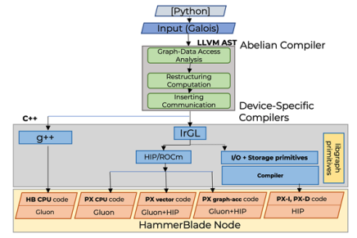
PANDO Compiler Toolchain
Galois programming model
Parallel patterns
Concurrent data structures
LLVM-based backend
CPU binaries
S2S → CUDA, ROCm, OpenCL
BSP+MPI execution model
Multiple Layers of Compilers
Abelian: Galois->BSP+CUSP
IrGL: Galois->Accelerators

Slide 32
PANDO Compilation Flow Key Ideas
Accept High-level Specification
Abelian Compiler
Transforms shared memory graph algorithms → distributed
Inserts communication primitives (Gluon/MPI)
RQ1: Role of vertex programs, overlapping partitions
RQ2: Adapting comm. model + Abelian to PANDO HW and lower-layer RTs
IrGL Compiler
Compiler for *kernels*
HLL spec → Accelerator spec (e.g. CUDA/OpenCL)
RQ3: Defining primitives/interfaces for PX-* accelerators
RQ4: How to retarget IrGL to PANDO accelerators

Slide 33
IrGL Compiler Key Ideas
Start from a high-level description of algorithm
Use optimizing compiler to generate accelerator code
IrGL targeted bottlenecks for irregular parallelism on GPUs
Atomics
Inner-loop serialization and load balance
Kernel launch overhead
Observations
All likely relevant on PX-vector processors
Will help with SIMD/SIMT parallelism on other PX-*,
But not necessarily with graph primitives like Set operations, layout transformations, etc.

Slide 34
Example: Level-by-Level BFS
0
1
1
1
2
2
2
2
2
2
Kernel bfs(graph, LEVEL)
ForAll(node in Worklist)
ForAll(edge in graph.edges(node))
if(edge.dst.level == INF)
edge.dst.level = LEVEL
Worklist.push(edge.dst)
src.level = 0
Iterate bfs(graph, LEVEL) [src] { LEVEL++ }

Slide 35
Review: Gluon API
Gluon[PLDI’18] provides efficient high level bulk synchronous API for synchronization:
A communication substrate to build distributed and heterogeneous graph analytics systems
Provides:
Graph partitioner (Edge-cuts and Vertex-cuts)
Communication-optimized runtime:
Exploits partitioning structural invariants
Avoids sending unnecessary meta-data
Abelian required:
To insert Gluon API calls for distributed execution
Provide information to exploit Gluon optimization
GPU
IrGL/CUDA/...
Gluon Plugin
CPU
Gluon Comm. Runtime
Galois/Ligra/...
CPU
Gluon Plugin
Gluon Comm. Runtime
Gluon Comm. Runtime
Partitioner
Partitioner
Network (LCI/MPI)
Network (LCI/MPI)
Galois [SoSP’13]
Ligra [PPoPP’13]
IrGL [OOPSLA’16]
LCI [IPDPS’18]

Slide 36
Shared Memory Galois PageRank (Input)
struct pageRank() {
Graph* g
pageRank(Graph* g) : g(g) {}
void operator()(GNode src, Worklist& wl) {
auto& srcData = g->getData(src);
auto residual_old = srcData.residual.exchange(0);
srcData.rank += residual_old;
auto delta = residual_old*alpha/srcData.nout;
for(auto e : g->getEdges(src)) {
GNode dst = g->getEdgeDst(e);
auto& dstData = g->getData(dst);
dstData.residual += delta;
if(dstData.residual > tolerance) {
wl.push(dst);
}
}
}
}
while (!wl.empty()) { Galois::do_all(wl, pageRank{&g}; }
Graph node labels:
rank, residual, nout
Asynchronous execution
Push-style operator
Update residual on immediate neighbors
Work-list based
Apply operator to items in work-list
Push new active nodes to work-list
Notes:
Animation in the code.
Include do_all
And node attributes
Just this much code….. Simple code + compiler will handle everything
nothing distributed , nothing device specific;… don’t read the code + this is all the code

Slide 37
Distributed Heterogeneous PageRank (Output)
do{
Galois:do_all (graph.getSources(), pageRank{&graph, alpha, tolerance});
Flag_rank.set_writeSrc();
Flag_contrib.set_reduceDst();
If(Flag_contrib.is_reduceDst()) {
graph.sync<reduceDst, readSrc, Add_contrib, Bcast_contrib>(Bitvec_contrib);
Flag_contrib.reset_reduceDst();
} else if (Flag_contrib.is_reduceDst()) {
…
} else { … }
Galois:do_all (graph.getSources(), pageRank_split{&graph});
Flag_residual.set_writeSrc();
}while(work_done.reduce());
struct pageRank() {
Graph* g
pageRank(Graph* g) : g(g) {}
DistributedAcc work_done;
void operator()(GNode src,
Worklist& wl) {
if(srcData.residual > tolerance) {
…
for(auto e : g->getEdges(src)) {
…
dstData.contrib += delta;
}
}}
struct pageRank_split() {
Graph* g;
void operator()(GNode src) {
auto& srcData = g->getData(src);
srcData.residual += srcData.contrib;
srcData.contrib = 0;
}
Graph node labels:
rank, residual, nout, contrib
BSP style execution
Operators:
pageRank and pageRank_split
Filter-based data-driven
On-demand communication
Gluon sync calls

Slide 38
Input to output
Code Transformations:
Required transformation
Asynchronous to BSP style of execution
Closure conversion for heterogeneous execution
Optimization transformation
Work-list elimination
Communication optimizations:
On-demand communication
Fine-grain synchronizations

Slide 39
Code Transformations

Slide 40
Asynchronous to BSP Execution
Fine-grain synchronization needed
Reading and writing residual at source
Updating residual at destination on immediate neighbors
BSP execution does not permit fine grain synchronization
Hosts see different values during computation phase due to disjoint address space
Requires synchronization
struct pageRank() {
Graph* g
pageRank(Graph* g) : g(g) {}
void operator()(GNode src, Worklist& wl) {
auto& srcData = g->getData(src);
auto residual_old = srcData.residual.exchange(0);
srcData.rank += residual_old;
auto delta = residual_old*alpha/srcData.nout;
for(auto e : g->getEdges(src)) {
GNode dst = g->getEdgeDst(e);
auto& dstData = g->getData(dst);
dstData.residual += delta;
if(dstData.residual > tolerance) {
wl.push(dst);
}
}
}

Slide 41
Restructuring Computation: Required Transformation 1
Fine-Grain iteration-level to round based BSP
Splitting operator:
PageRank: read and write access
PageRank_split: reduction
Introduce new variables (contrib)
struct pageRank() {
Graph* g;
float &local_alpha, &local_tolerance
pageRank(Graph* g) : g(g) {}
void operator()(GNode src, Worklist& wl) {
auto& srcData = g->getData(src);
auto residual_old = srcData.residual.exchange(0);
srcData.rank += residual_old;
auto delta = residual_old*local_alpha/srcData.nout;
for(auto e : g->getEdges(src)) {
GNode dst = g->getEdgeDst(e);
auto& dstData = g->getData(dst);
dstData.contrib += delta;
if(dstData.contrib > local_tolerance) {
wl.push(dst);
}
} }
struct pageRank_split() {
Graph* g;
pageRank_split(Graph* g) : g(g) {}
void operator()(GNode src) {
auto& srcData = g->getData(src);
srcData.residual += srcData.contrib;
srcData.contrib = 0;
}

Slide 42
Transformations for Heterogeneous Execution
Global variables present
tolerance and alpha
Heterogenous hosts may not share common visible memory space
struct pageRank() {
Graph* g
pageRank(Graph* g) : g(g) {}
void operator()(GNode src, Worklist& wl) {
auto& srcData = g->getData(src);
auto residual_old = srcData.residual.exchange(0);
srcData.rank += residual_old;
auto delta = residual_old*alpha/srcData.nout;
for(auto e : g->getEdges(src)) {
GNode dst = g->getEdgeDst(e);
auto& dstData = g->getData(dst);
dstData.contrib += delta;
if(dstData.contrib > tolerance) {
wl.push(dst);
}
}
}

Slide 43
Restructuring Computation: Required Transformation 2
Eliminating global variables:
Make operators self contained (closure conversion)
Introduce corresponding local variables
struct pageRank() {
Graph* g;
float &local_alpha, &local_tolerance
pageRank(Graph* g) : g(g) {}
void operator()(GNode src, Worklist& wl) {
auto& srcData = g->getData(src);
auto residual_old = srcData.residual.exchange(0);
srcData.rank += residual_old;
auto delta = residual_old*local_alpha/srcData.nout;
for(auto e : g->getEdges(src)) {
GNode dst = g->getEdgeDst(e);
auto& dstData = g->getData(dst);
dstData.contrib += delta;
if(dstData.contrib > local_tolerance) {
wl.push(dst);
}
} }
Local Variables

Slide 44
Optional Optimization Transformation
Work-list elimination Optimization
Distributed work-list required
Needs synchronization
struct pageRank() {
Graph* g;
float &local_alpha, &local_tolerance
pageRank(Graph* g) : g(g) {}
void operator()(GNode src, Worklist& wl) {
auto& srcData = g->getData(src);
auto residual_old = srcData.residual.exchange(0);
srcData.rank += residual_old;
auto delta = residual_old*local_alpha/srcData.nout;
for(auto e : g->getEdges(src)) {
GNode dst = g->getEdgeDst(e);
auto& dstData = g->getData(dst);
dstData.contrib += delta;
if(dstData.residual > local_tolerance) {
wl.push(dst);
}
} }

Slide 45
Restructuring Computation: Optimization Transformation
Conversion to filter based data-driven algorithm:
Avoid distributed work-list synchronization overhead
Conditional used to push work is used to filter
struct pageRank() {
Graph* g;
float &local_alpha, &local_tolerance
pageRank(Graph* g) : g(g) {}
void operator()(GNode src, Worklist& wl) {
auto& srcData = g->getData(src);
if(srcData.residual > local_tolerance) {
auto residual_old = srcData.residual.exchange(0);
srcData.rank += residual_old;
auto delta = residual_old*local_alpha/srcData.nout;
for(auto e : g->getEdges(src)) {
GNode dst = g->getEdgeDst(e);
auto& dstData = g->getData(dst);
dstData.contrib += delta;
}
}

Slide 46
Analysis and Inserting communication
Notes:
1. After doing the required transformations, we will now look at how compiler analyses the code and inserts the communication for distributed execution

Slide 47
Information Required by Gluon Synchronization API
Application-specific:
What: Field to synchronize
When: Point of synchronization
How: Reduction operator to use
Optional information for optimization:
Field specific bit-set to track updated fields
Precise read and write locations for exploiting structural invariant optimization

Slide 48

Graph-Data Access Analysis
Input
Galois
Fields accessed on graph Nodes (What)
Operator field access types (How) :
Reduction: Field is read and updated using reduction operation (inside edge iterator)
Read: Field is only read
Write: Field is written (not part of a reduction)
Operator field access location:
At source: At the source of an edge
At destination: At the destination of an edge
At any: At the node or both end points of edge
LLVM AST
Abelian
Compiler
Graph-Data Access Analysis
Restructuring Computation
Inserting Communication
Device Specific
Compilers
C++
g++
IrGL
CUDA
OpenCL
CPU code
GPU code
Gluon Runtime
Gluon Runtime

Slide 49
PageRank Example
Field accessed: contrib, residual, rank
Reduction operation (contrib): +=
Field accessed location:
residual and rank
Read at source
contrib
Updated at destination
struct pageRank() {
Graph* g;
float &local_alpha, &local_tolerance
pageRank(Graph* g) : g(g) {}
void operator()(GNode src, Worklist& wl) {
auto& srcData = g->getData(src);
if(srcData.residual > local_tolerance) {
auto residual_old = srcData.residual.exchange(0);
srcData.rank += residual_old;
auto delta = residual_old*local_alpha/srcData.nout;
for(auto e : g->getEdges(src)) {
GNode dst = g->getEdgeDst(e);
auto& dstData = g->getData(dst);
dstData.contrib += delta;
}
}

Slide 50
Inserting Communication
Input
Galois
LLVM AST
Abelian
Compiler
Graph-Data Access Analysis
Restructuring Computation
Inserting Communication
Device Specific
Compilers
C++
g++
IrGL
CUDA
OpenCL
CPU code
GPU code
Gluon Runtime
Gluon Runtime
Notes:
Now let’s look at how Abelian inserts communication

Slide 51
Inserting Naïve Communication: UnOptimized PageRank
Inserting Gluon sync API calls
struct pageRank() {
Graph* g;
float &local_alpha, &local_tolerance
pageRank(Graph* g) : g(g) {}
void operator()(GNode src, Worklist& wl) {
…
}
}
while(!workDone){
Galois:do_all (graph.getSources(), pageRank{&graph, alpha, tol});
graph.sync<reduceAny, readAny, Add_contrib, Bcast_contrib>();
Galois:do_all (graph.getSources(), pageRank_split{&graph});
graph.sync<reduceAny, readAny, Add_residual, Bcast_residual>();
}
struct pageRank_split() {
Graph* g;
pageRank_split(Graph* g) : g(g) {}
void operator()(GNode src) {
…
}
}

Slide 52
Communication optimizations Optimization 1:
PageRank Operator
Contrib updated
Naïve synchronization:
Conservative approach
contrib updated in pageRank operator
PageRank_split Operator
Contrib read
Data flow diagram
Contrib variable

Slide 53
Communication optimizations Optimization 1:
PageRank Operator
Contrib updated
Sync contrib
Naïve synchronization:
Conservative approach
contrib updated in pageRank operator
Sync contrib after pageRank operator
PageRank_split Operator
Contrib read
Data flow diagram
Contrib variable

Slide 54
Communication optimizations Optimization 1:
PageRank Operator
Contrib updated
On-demand synchronization:
Only sync before operator if required
Sync before using contrib on-demand in pageRank_split before reading
PageRank_split Operator
Contrib read
Sync contrib
Data flow diagram
Contrib variable

Slide 55
Communication optimizations Optimization 1:
Inserting on-demand communication:
Field specific sync-state flags
Before operator:
Checks sync-state flags with precise read/write location provided by Abelian
Calls Gluon sync if required.
After operator:
Inserts code to set or invalidate field-specific sync-state flags (uses write location)
Notes:
Additional information from Abelian:
Abelian precisely identifies abstract read and write location
Exploits Gluon’s structural invariant optimization

Slide 56
Inserting On-demand Communication: PageRank example
Inserting on-demand communication
Insert and Set sync flags
Check sync flags and insert Gluon sync calls
Galois:do_all (graph.getSources(), pageRank{&graph,
alpha, tolerance});
Flag_rank.set_writeSrc();
Flag_contrib.set_reduceDst();
If(Flag_contrib.is_reduceDst()) {
graph.sync<reduceDst, readSrc, Add_contrib,
Bcast_contrib>(Bitvec_contrib);
Flag_contrib.reset_reduceDst();
} else if (Flag_contrib.is_reduceDst()) {
…
} else { … }
Galois:do_all (graph.getSources(), pageRank_split{&graph});
Flag_residual.set_writeSrc();
Notes:
1. It adds extra logic to check and set/invalidate sync flags

Slide 57
A Compiler for Throughput Optimization of Graph Algorithms on GPUs
Sreepathi Pai Keshav Pingali
The University of Texas at Austin
November 16, 2016

Slide 58
Outline
Approaches to Graph Algorithms on GPUs
IrGL Compiler and Optimizations
Bottleneck #1: Atomics
Bottleneck #2: Inner-loop Serialization
Bottleneck #3: Short Kernel Launches
Results
Performance Models for Graph Algorithms on GPUs

Slide 59
Approaches to Graph Algorithms on GPUs

Slide 60
Graph Algorithms on GPUs
GPUs excel on regular data-parallel code
e.g. Matrix Multiply
Graph algorithms on GPUs?
Good: Require lots of bandwidth
GPU memory bandwidth is 288GB/s
CPU memory bandwidth is 25GB/s
Bad: Data-parallel, but not regular

Slide 61
Approach #1: CUDA/OpenCL Implementations
Breadth-First Search (BFS) [Merrill et al., 2012]
Connected Components (CC) [Soman et al., 2010]
Delaunay Mesh Refinement (DMR) [Nasre et al., 2013]
Maximal Independent Set (MIS) [Che et al., 2013]
Minimum Spanning Tree (MST) [da Silva Sousa et al. 2015]
PageRank (PR) [Elsen and Vaidyanathan, 2014]
Single-Source Shortest Path (SSSP) [Davidson et al. 2014]
Triangle Counting (TRI) [Polak et al. 2015]

Slide 62
Approach #2: Graph Analytics Frameworks
C++ Template-based Frameworks
VertexAPI2 [Elsen and Vaidyanathan, 2014]
MapGraph [Fu et al, GRADES 2014]
Gunrock [Wang et al., PPoPP 2016]
Targeted towards graph analysts
Restricted to limited set of algorithms
Vertex programs
Immutable graphs

Slide 63
Our Approach: IrGL Compiler
Start from a high-level description of algorithm
Use optimizing compiler to generate CUDA
Advantages
Raises abstraction level for programmers
Does not sacrifice performance
Allows automatic exploration of optimizations
Road networks often require different optimizations compared to social networks

Slide 64
Example: Level-by-Level BFS
0
1
1
1
2
2
2
2
2
2
Kernel bfs(graph, LEVEL)
ForAll(node in Worklist)
ForAll(edge in graph.edges(node))
if(edge.dst.level == INF)
edge.dst.level = LEVEL
Worklist.push(edge.dst)
src.level = 0
Iterate bfs(graph, LEVEL) [src] { LEVEL++ }

Slide 65
Importance of Optimizations
Unoptimized Kernel
~15 lines of CUDA
505ms on USA road network graph
Optimized Kernel
~200 lines of CUDA
120ms on the same graph
4.2x Performance Difference!

Slide 66
IrGL Compiler and Optimizations

Slide 67
IrGL Constructs
Representation for irregular data-parallel algorithms
Parallelism
ForAll
Synchronization
Atomic
Exclusive
Worklist Management
Iterate
Pipe

Slide 68
IrGL Synchronization Constructs
Atomic: Blocking atomic section Atomic (lock) { critical section }
Exclusive: Non-blocking, atomic section to obtain multiple locks with priority for resolving conflicts Exclusive (locks) { critical section }

Slide 69
IrGL Worklist Construct: Pipe
Pipe allows multiple kernels to share the same worklist
All items pushed by a kernel are forwarded to the next (dynamic) kernel
Pipe is a general form of Iterate on worklists
Pipe { // input: bad triangles // output: new triangles Invoke refine_mesh(...)
// check for new bad tri. Invoke chk_bad_tri(...) }
refine_mesh
not worklist.empty()
chk_bad_tri

Slide 70
IrGL Compiler
Converts IrGL abstract syntax trees to CUDA
Generated CUDA code can be embedded into larger programs
IrGL intended for writing kernels, not full programs
IrGL compiler implemented as a library
Python-callable
IrGL ASTs are valid Python programs

Slide 71
Bottleneck #1: Atomics
Kernel bfs(graph, LEVEL)
ForAll(node in Worklist)
ForAll(edge in graph.edges(node))
if(edge.dst.level == INF)
edge.dst.level = LEVEL
Worklist.push(edge.dst)
src.level = 0
Iterate bfs(graph, LEVEL) [src] { LEVEL++ }
pos = atomicAdd(Worklist.length, 1)
Worklist.items[pos] = edge.dst
Atomic Throughput on GPU: 2.4GB/s
Memory bandwidth: 288GB/s

Slide 72
Reducing Atomics by Aggregation
atomicAdd(..., 5)
atomicAdd(..., 1)
Write
Thread
Thread

Slide 73
Handling Conditional Pushes
if(edge.dst.level == INF)
Worklist.push(edge.dst)
...
Time

Slide 74
Aggregation in GPUs
Intra-Warp
...
Lockstep execution, easily aggregated
0
31
Intra-Thread Block
...
...
...
...
0
31
64
95
32
63
Barrier required, so trickier to aggregate in conditionals

Slide 75
Warp-level Aggregation
Kernel bfs_kernel(graph, ...)
ForAll(node in Worklist)
ForAll(edge in graph.edges(node))
if(edge.dst.level == INF)
...
start = Worklist.reserve_warp(1)
Worklist.write(start, edge.dst)

Slide 76
Inside reserve_warp
(assume a warp has 8 threads)
T0 | T1 | T2 | T3 | T4 | T5 | T6 | T7
1 | 0 | 1 | 1 | 0 | 1 | 1 | 0
size
(warp prefix sum)
T0 | T1 | T2 | T3 | T4 | T5 | T6 | T7
0 | 1 | 1 | 2 | 3 | 3 | 4 | 5
_offset
T0: pos = atomicAdd(Worklist.length, 5) broadcast pos to other threads in warp
return pos + _offset

Slide 77
Thread-block Aggregation?
Kernel bfs(graph, ...)
ForAll(node in Worklist)
ForAll(edge in graph.edges(node))
if(edge.dst.level == INF)
start = Worklist.reserve_tb(1)
Worklist.write(start, edge.dst)
reserve_tb contains a CUDA barrier
All threads in thread block must execute barrier
But:
if(edge.dst.level == INF) is not uniform
ForAll(edge …) is not uniform

Slide 78
Uniform Branches
Uniform Branch
A branch that is decided the same way by all threads [in scope of a barrier]
Uniform If
All threads decide the condition the same way
Uniform While, For
All threads execute same number of iterations

Slide 79
Uniform Branches to Focal Points
A barrier is placed correctly if it is control-dependent only on uniform branches
A focal point is a node in the control-flow graph (CFG) that is iteratively control-dependent only on uniform branches, other than possibly itself.
Use the control-dependence graph (CDG) to identify focal points

Slide 80
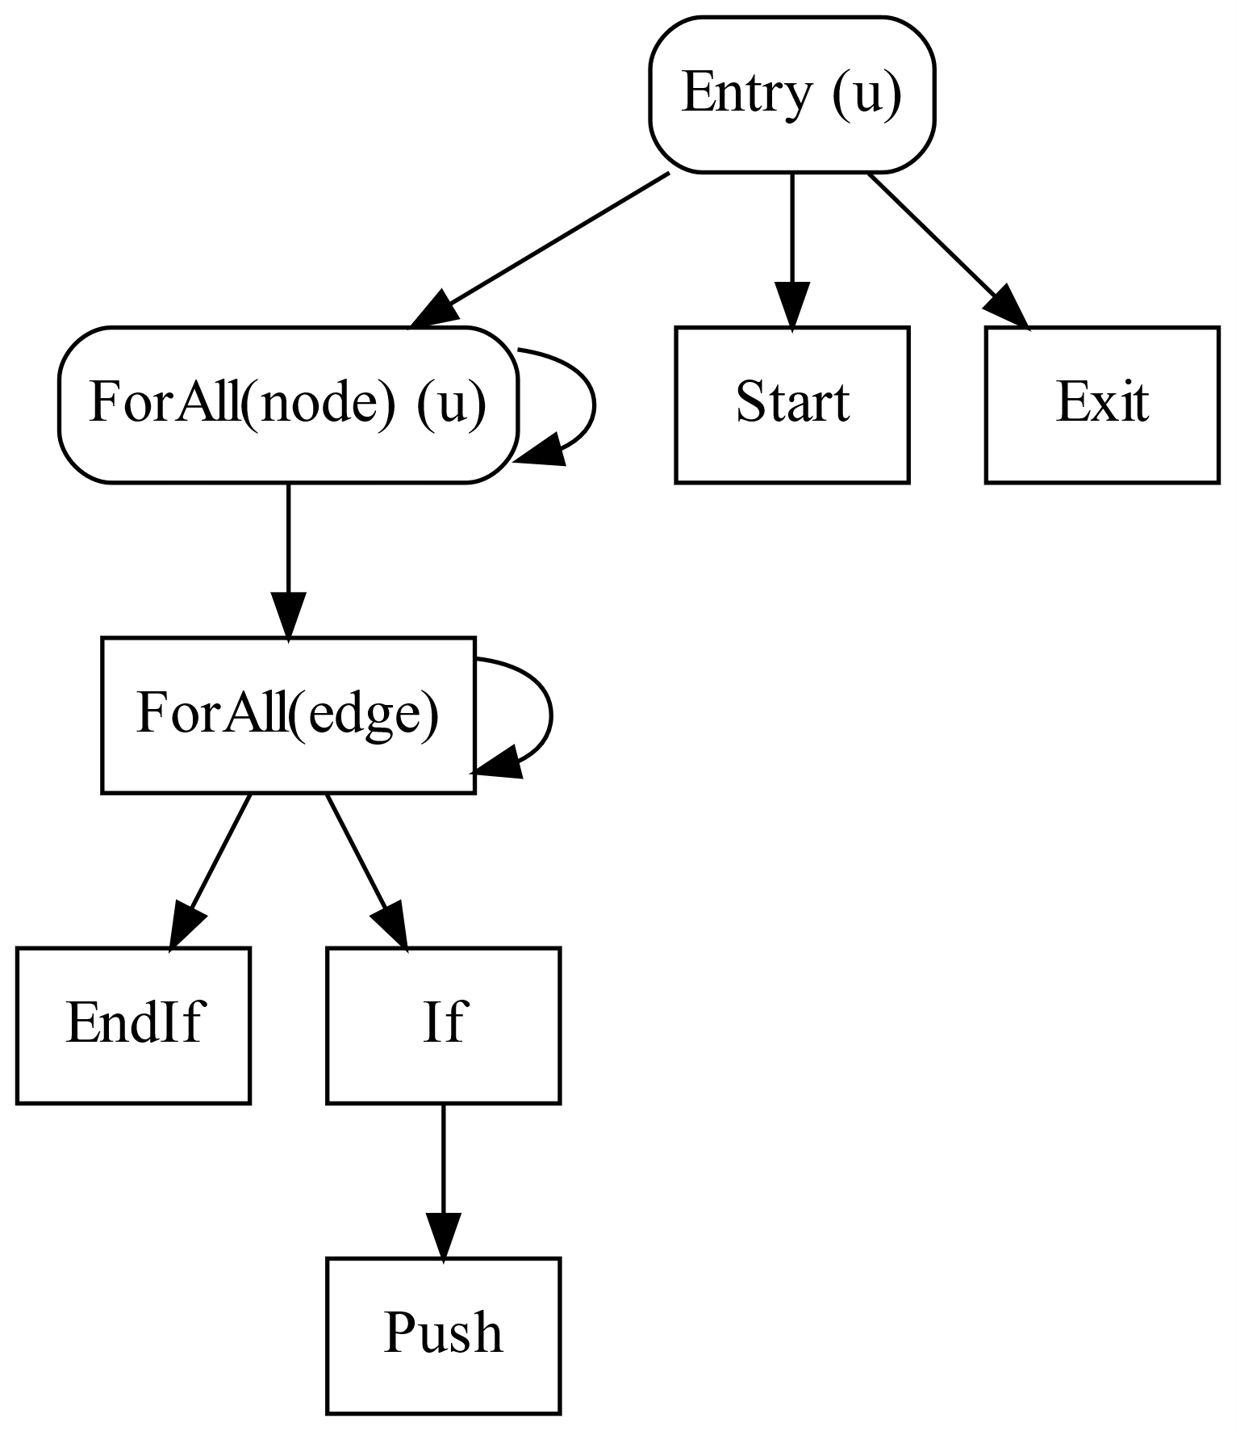
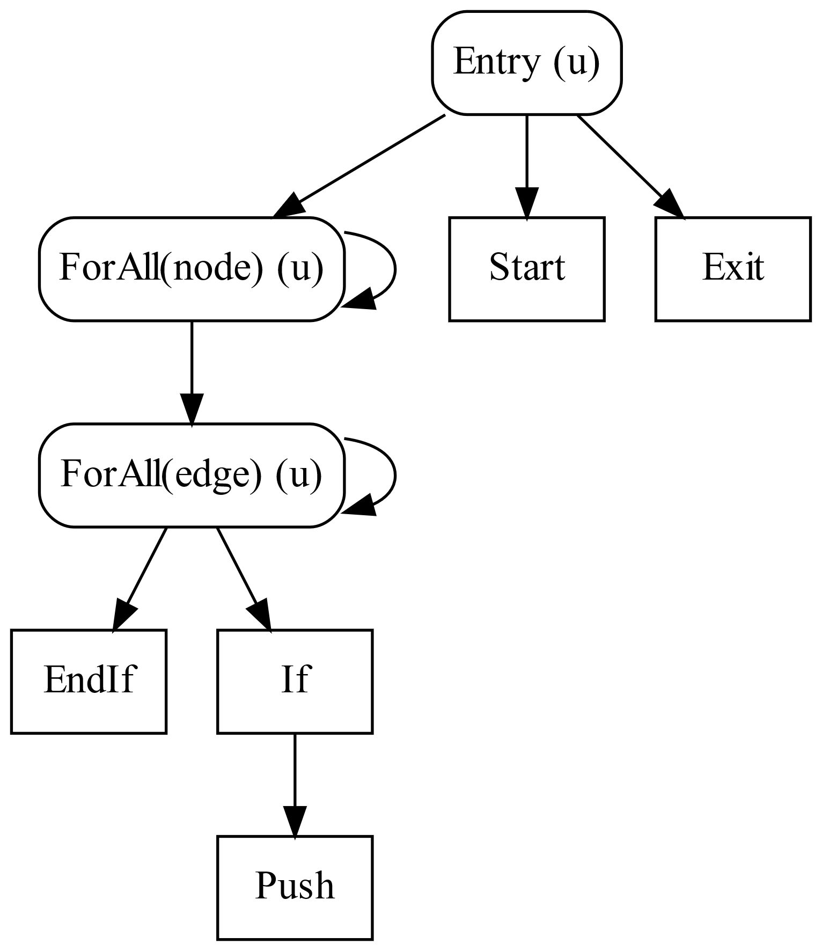
Focal Points from the CDG

Slide 81
reserve_tb placed
Kernel bfs(graph, ...)
ForAll(node in Worklist)
UniformForAll(edge in graph.edges(node))
will_push = 0
if(edge.dst.level == INF)
will_push = 1
to_push = edge
start = Worklist.reserve_tb(will_push)
Worklist.write_cond(willpush, start, to_push)

Slide 82
Cooperative Conversion
Optimization to reduce atomics by cooperating across threads
Compiler supports all 3 levels
Thread
Warp (32 threads in GPU)
Thread Block (upto 32 warps)
Compiler can safely place barriers
Focal Point Analysis

Slide 83
Bottleneck #2: Inner-loop serialization
Kernel bfs(graph, LEVEL)
ForAll(node in Worklist)
ForAll(edge in graph.edges(node))
if(edge.dst.level == INF)
edge.dst.level = LEVEL
Worklist.push(edge.dst)
src.level = 0
Iterate bfs(graph, LEVEL) [src] { LEVEL++ }
Power-law graphs can have millions of edges per node

Slide 84
Inner-loop Serialization
One node per thread
(Inner loop serialized)

Slide 85
Parallel Execution of Inner Loop
Thread-block (TB) Scheduling
Fine-grained (FG) Scheduling
Example schedulers from Merrill et al., Scalable GPU Graph Traversal,
PPoPP 2012

Slide 86
Inspector/Executor Parallelization
a
b
c
Inspect
(at runtime)
d
e
f
1
1
1
Thread-block Scheduling
a
b
c
d
e
f
a
b
c
d
e
f
Fine-grained Scheduling

Slide 87
General Scheme for NP
for(nidx=tid; nidx < worklist.size; nidx+=nthreads)
Create Closure for inner loop iterations
Perform Inspection
while(work) {
Retrieve Closure
Execute Inner-loop Iterations
}
__syncthreads();
Scheduler 2
__syncthreads();
Scheduler N
__syncthreads();
}
Note: Uniform Loops

Slide 88
Multiple Schedulers are needed!
Policy | BFS | SSSP-NF | Triangle
Serial | 1.00 | 1.00 | 1.00
TB | 0.25 | 0.33 | 0.46
Warp | 0.86 | 1.42 | 1.52
Finegrained (FG) | 0.64 | 0.72 | 0.87
TB+Warp | 1.05 | 1.40 | 1.51
TB+FG | 1.10 | 1.46 | 1.55
Warp+FG | 1.14 | 1.56 | 1.23
TB+Warp+FG | 1.15 | 1.60 | 1.24
Speedup relative to Serial execution of inner-loop iterations on RMAT22 graph
Higher is faster

Slide 89
Exploiting Nested Parallelism
Use Inspector/Executor approach
Compiler generates hybrid schedulers
Power-law graphs require hybrid schedulers
High-degree nodes: Thread-block scheduling
Low-degree nodes: Fine-grained scheduling
Best-performing schedulers vary by algorithm and input
Currently use auto-tuning to select schedulers

Slide 90
Bottleneck #3: Launching Short Kernels
Kernel bfs(graph, LEVEL)
ForAll(node in Worklist)
ForAll(edge in graph.edges(node))
if(edge.dst.level == INF)
edge.dst.level = LEVEL
Worklist.push(edge.dst)
src.level = 0
Iterate bfs(graph, LEVEL) [src] { LEVEL++ }
USA road network: 6261 bfs calls
Average call duration: 16 µs
Total time should be 16*6261 = 100 ms
Actual time is 320 ms

Slide 91
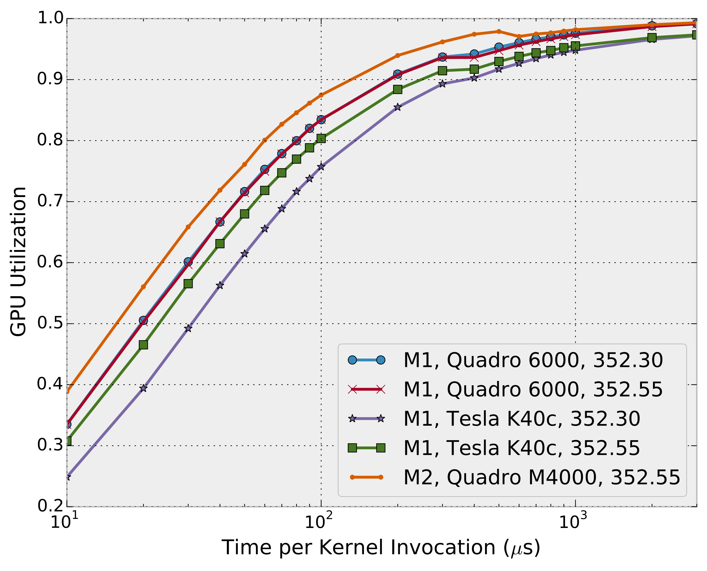
GPU Utilization for Short Kernels

Slide 92
Can we avoid short kernels?
Iterative Graph Algorithms use worklists
Current worklist depends on previous one
Can't batch work to increase length
Ironically, optimizing kernels is harmful!
The shorter the kernel, the more it suffers

Slide 93
Iterative Algorithm Timeline
CPU
GPU
CPU
GPU
launch
launch
bfs
bfs
Idling
bfs
bfs
bfs
Idling
bfs
bfs
Control Kernel
Idling
bfs
Time
Time

Slide 94
Iteration Outlining
“Outline” Iterate to GPU
Results in a single “control” kernel
Converts Kernel Launches to Function Calls
Launch control kernel once from CPU
Only returns to CPU once all iterations complete
Kernels in Iterate invoked via function calls on GPU

Slide 95
Summary
IrGL compiler performs 3 key optimizations
Cooperative Conversion
reduces atomics in lock-free data-structures
Nested Data Parallelism
reduces serialization
Iteration Outlining
eliminates kernel launch bottlenecks
Allows auto-tuning for optimizations

Slide 96
Results
Eight irregular algorithms
BFS, CC, DMR, MIS, MST, PR, SSSP, TRI
Tesla K40 GPU
Baselines were state-of-the-art implementations
Graphs
Road Networks: USA, CAL and NY
RMAT (synthetic): RMAT22, 20 and 16
Grid (1024x1024)
Meshes: 10M points, 5M points, 1M points

Slide 97
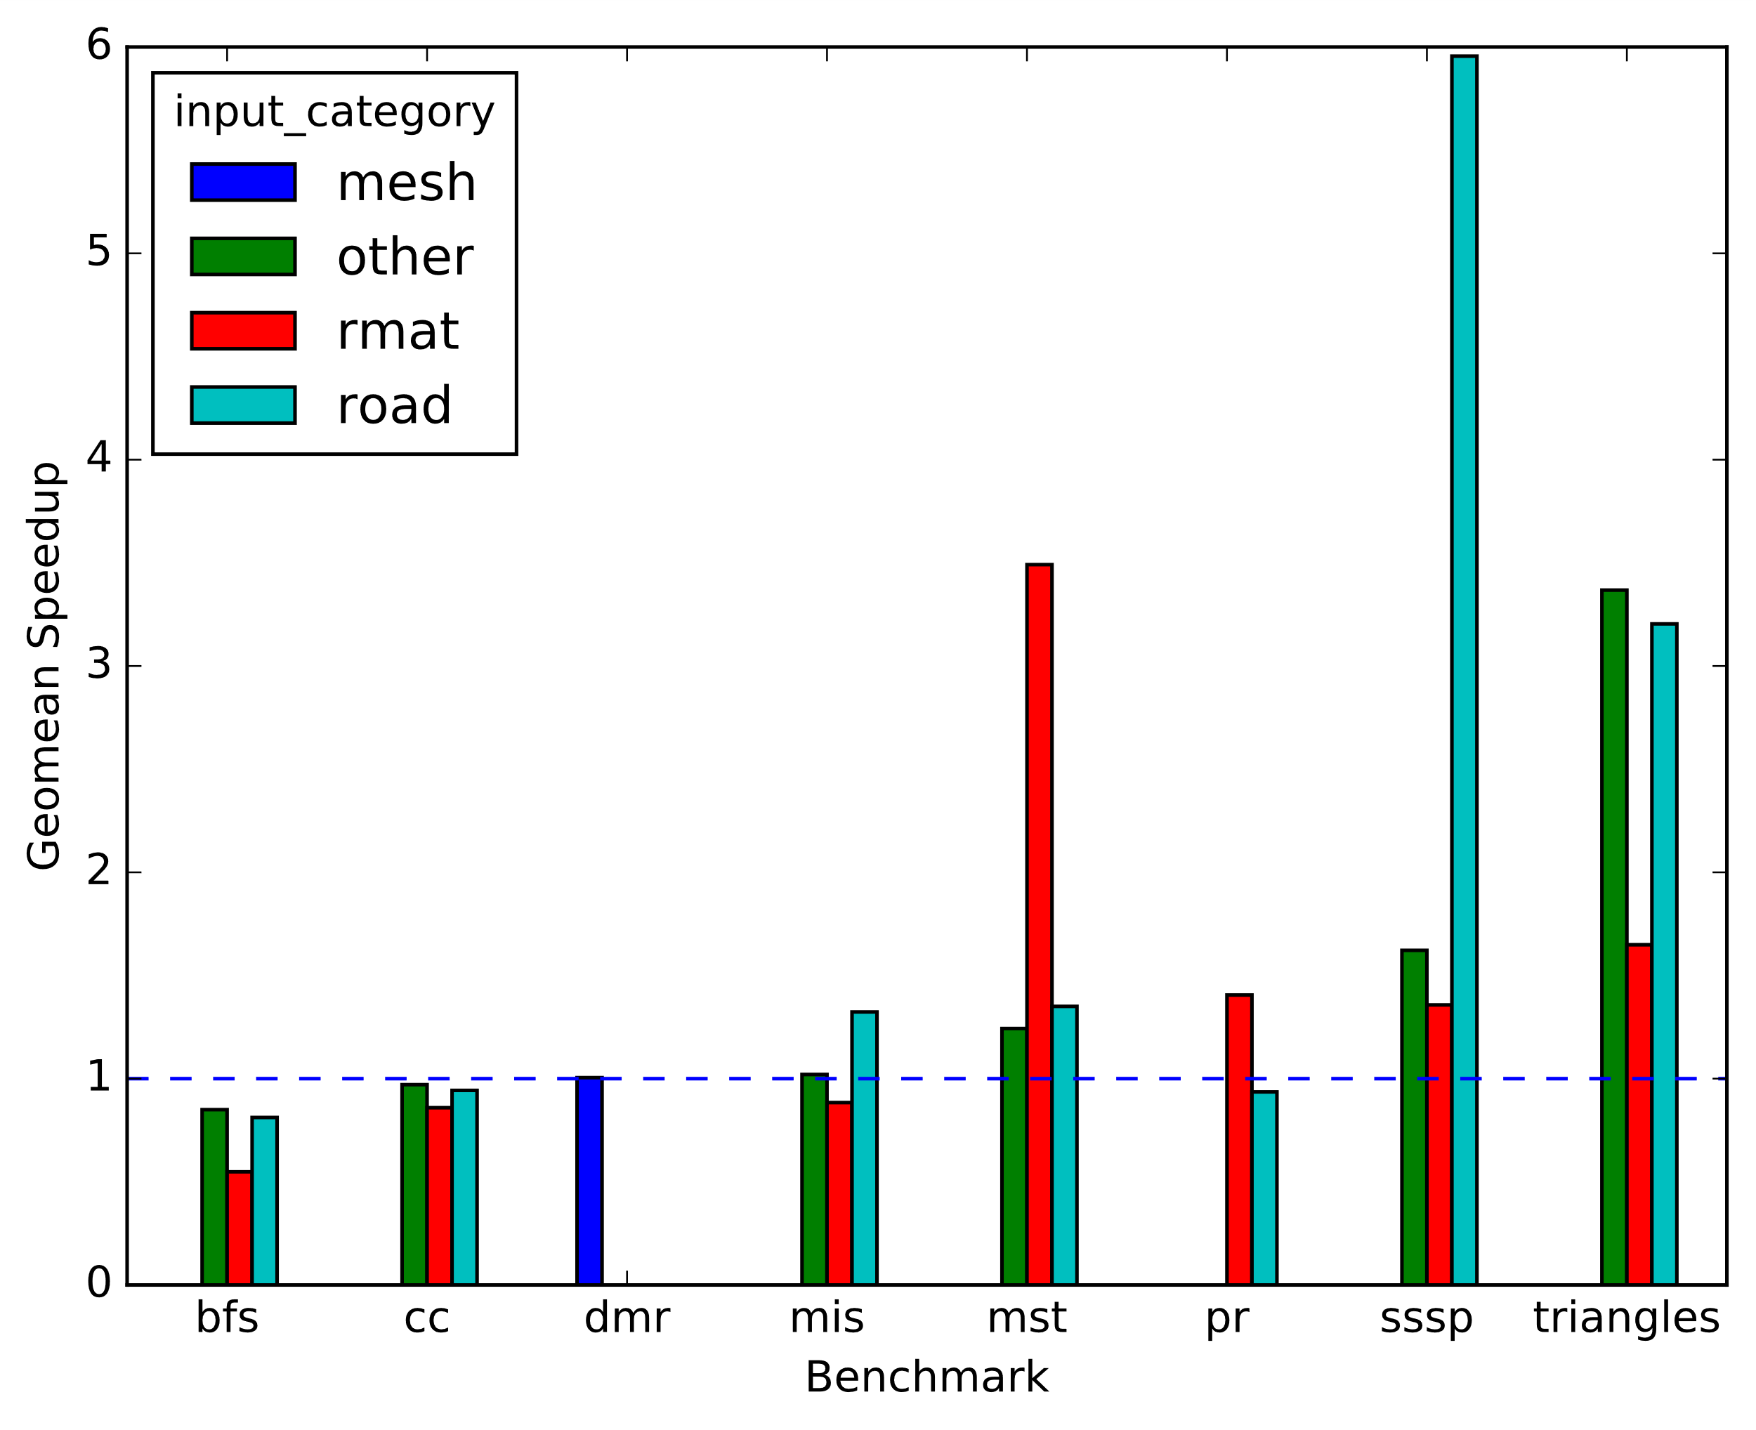
Overall Performance
Best
Handwritten
Code
Note: Each benchmark had a single set of optimizations applied to it

Slide 98
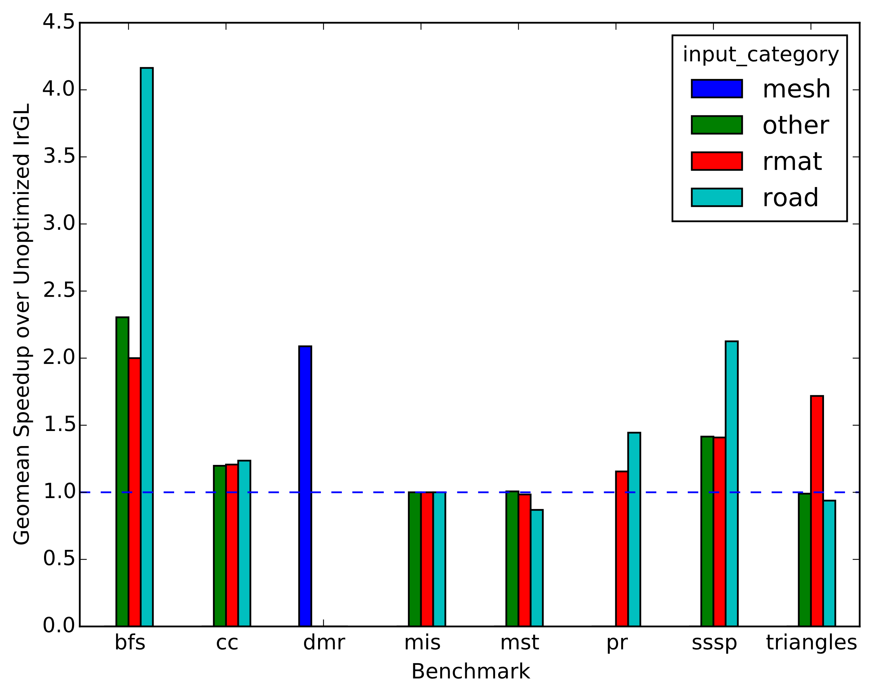
Contribution of Optimizations
Unoptimized
IrGL

Slide 99
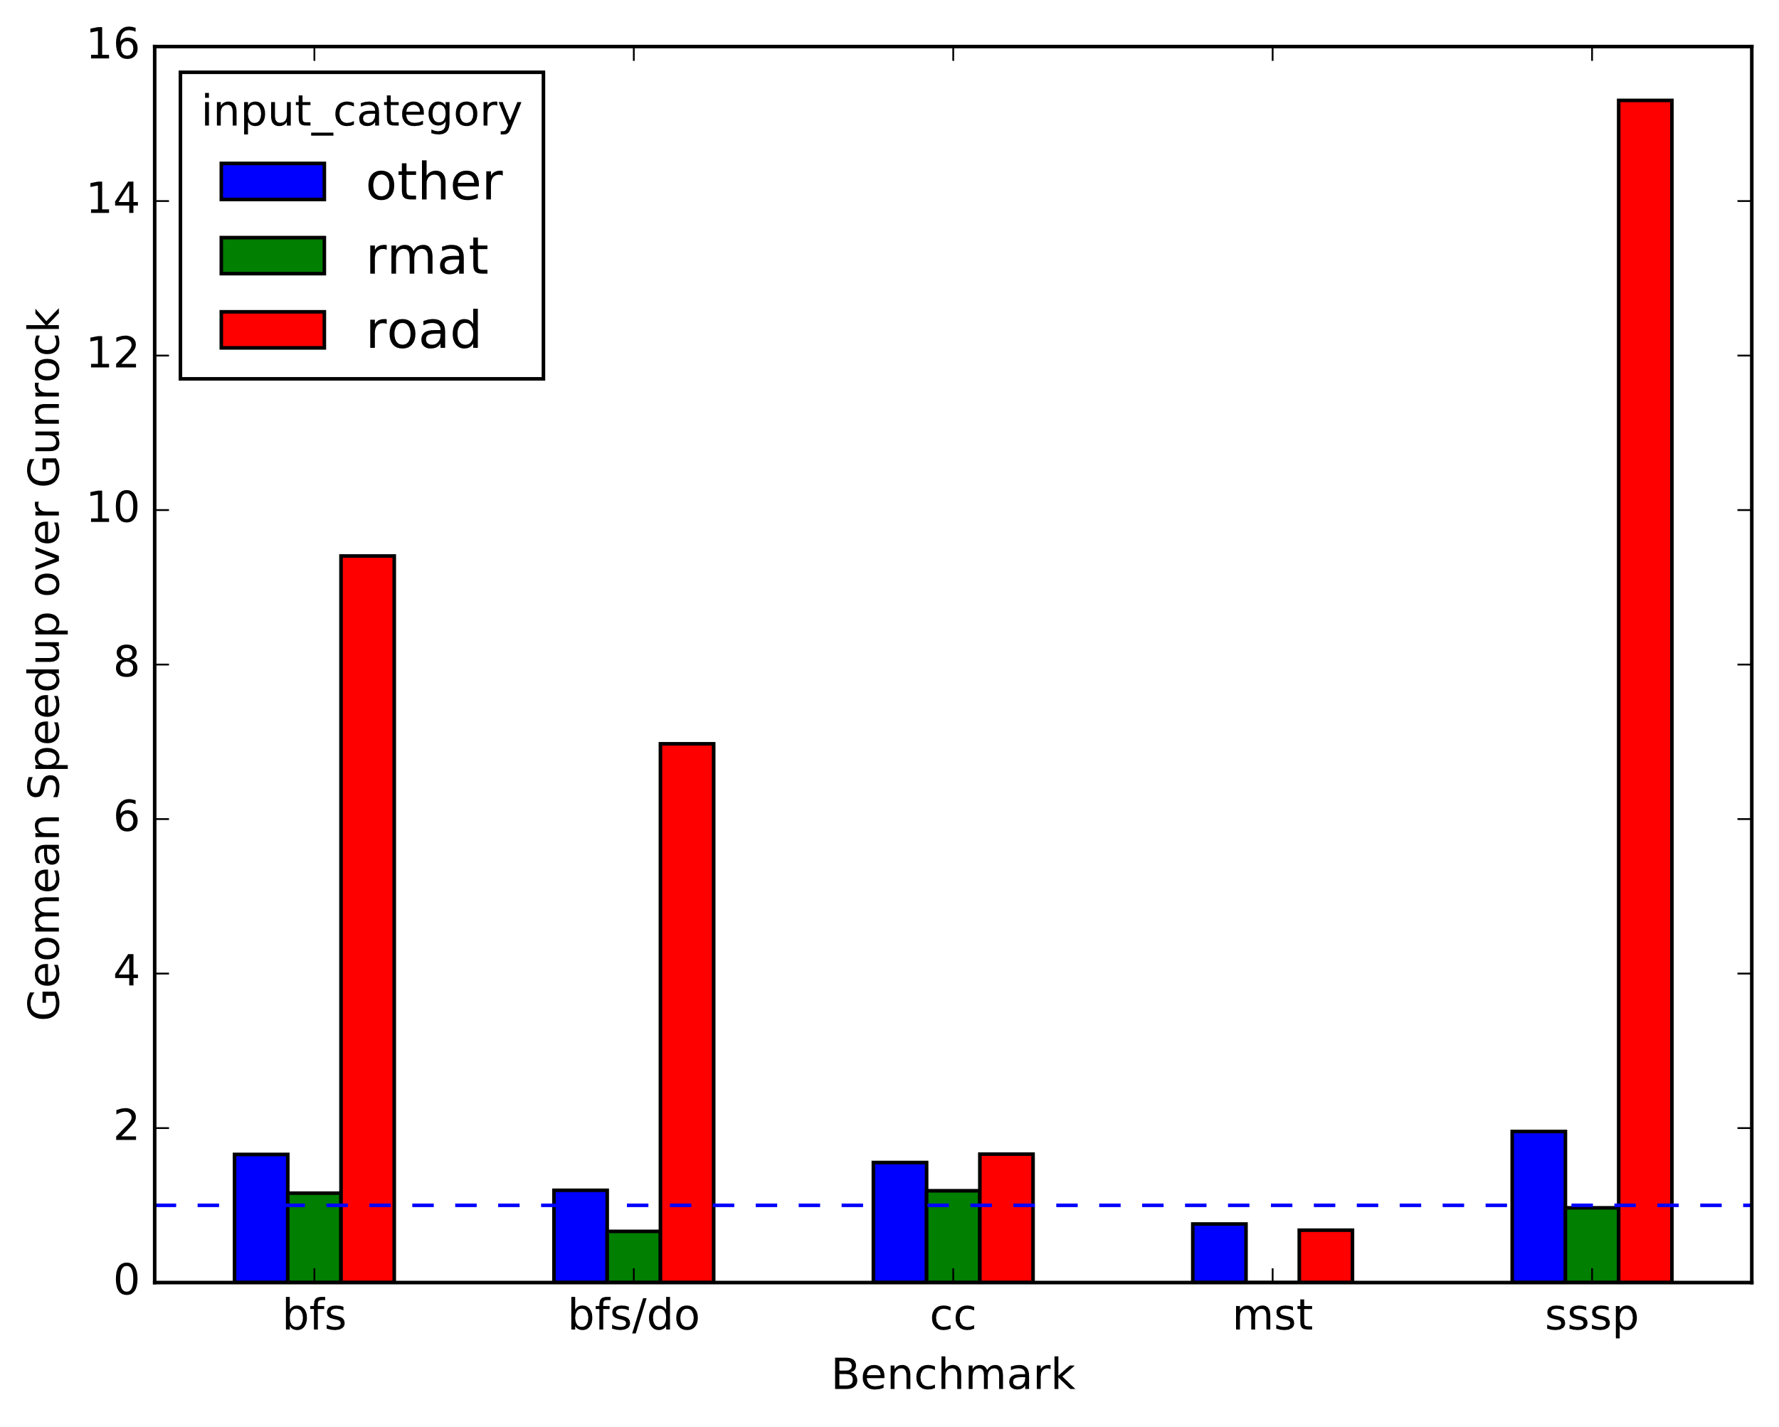
Comparison to Gunrock*
Gunrock
* Wang et al., Gunrock: A high-performance graph processing library on the GPU, PPoPP 2016

Slide 100
Understanding Performance
Graph program performance is poorly understood
Interaction of algorithm, input, implementation and hardware
Our compiler allows controlled experiments
Led to queuing model of graph programs

Slide 101
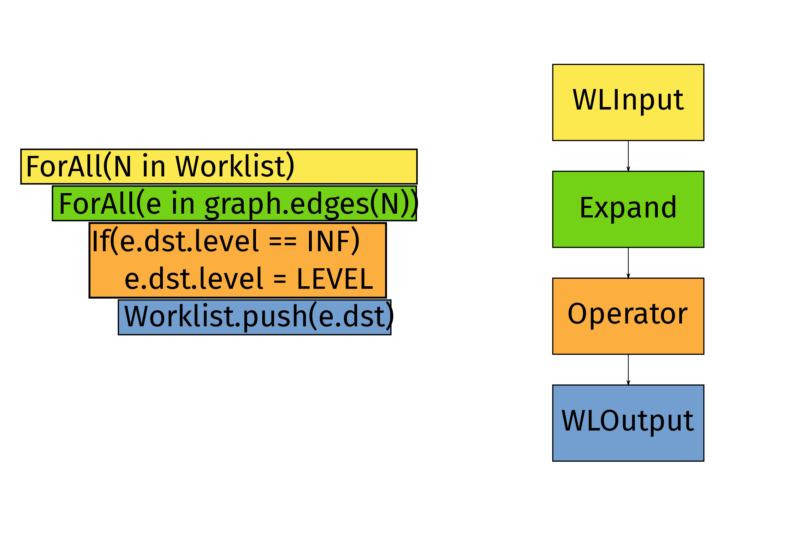
BFS as a Queuing Network

Slide 102
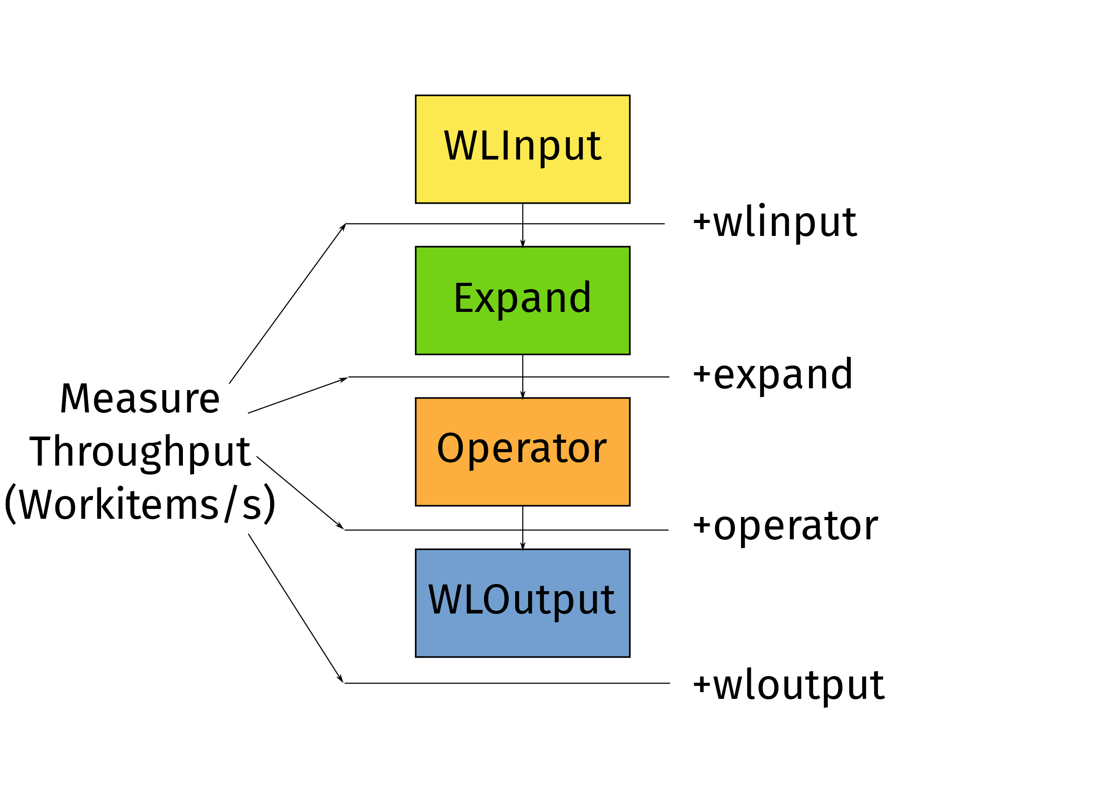
Microbenchmarking Peak Performance

Slide 103
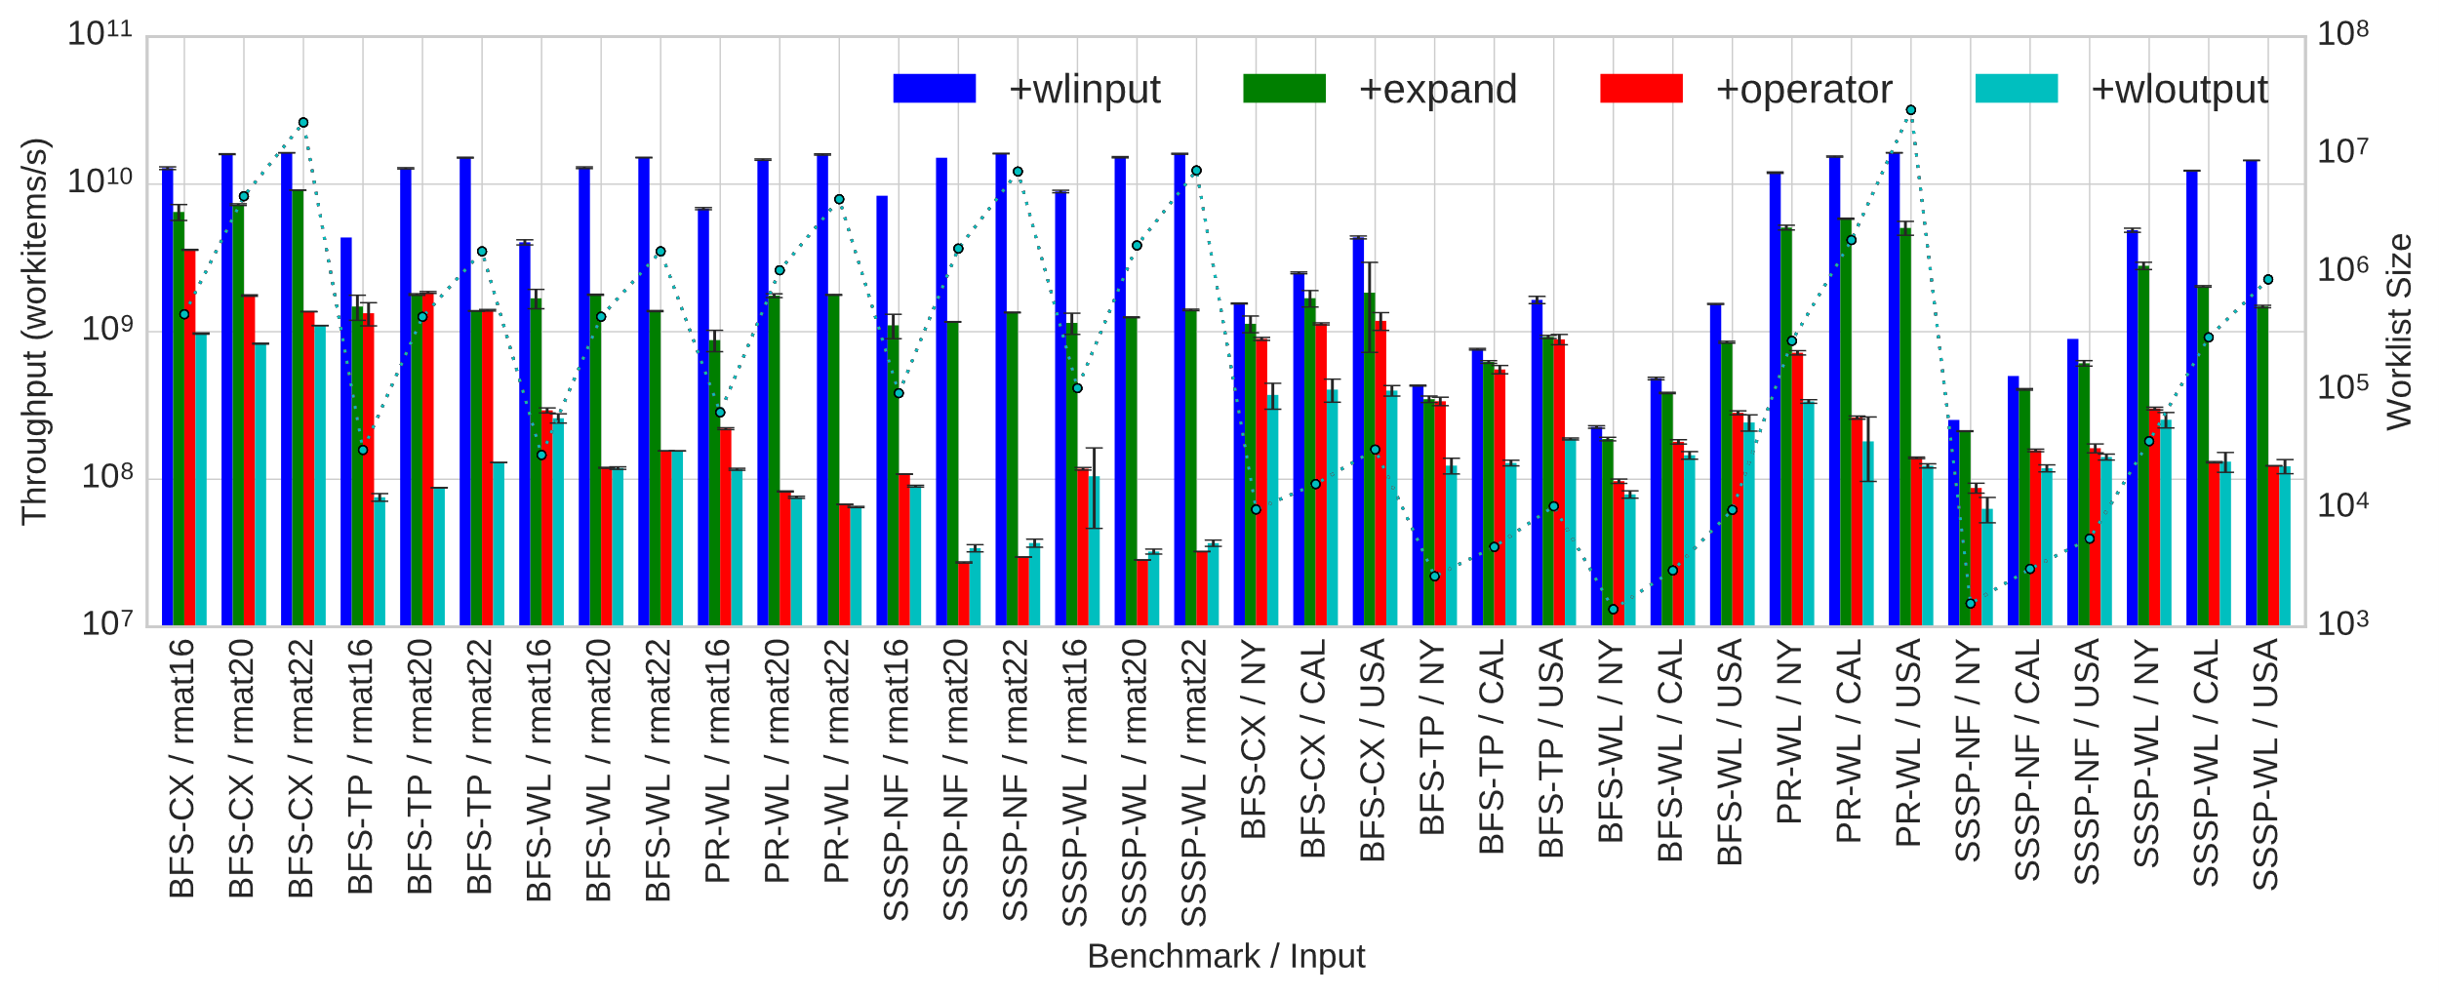
Peak Performance

Slide 104
Ongoing Work
Generate OpenCL from IrGL
With Tyler Sorensen and Alastair Donaldson (Imperial College London)
Generate IrGL from (Simplified) C++
With Andrew Lenharth, Roshan Dathathri and Gurbinder Gill (UT Austin)
Compile Graph Database Query languages (Apache Tinkerpop/Gremlin) to IrGL
Analytical Performance Models and Profile-Guided Optimization of IrGL programs

Slide 105
Conclusions
Graph algorithms on GPUs need three optimizations for high performance:
Cooperative Conversion (reduce atomics)
Nested Parallelism (reduce serialization)
Iteration Outlining (improve utilization)
These optimizations can be automated by a compiler
Our IrGL compiler implements these optimizations
Median speedup: 1.4x, upto 4.2x speedup

Slide 106
Thank you!
Questions?
sreepai@ices.utexas.edu

Slide 107
Short kernels or Launch overheads?
SSSP | Bellman-Ford |  | Near--Far
Input | NY | USA | NY | USA
Iterations | 813 | 5792 | 1893 | 49216
Avg. iteration time (µs) | 88.17 | 9168.5 | 18.5 | 20
Time (ms) | 123 | 53149 | 98.8 | 2536
Time (outlining, ms) | 88.5 | 60954 | 41.7 | 1149
Time (with DP, ms) | 94 | 53600 | 92 | 2448

Slide 108
IrGL
Intermediate representation
Represents irregular programs
Slightly higher-level than CUDA
Compiler-managed scheduling
High-level synchronization constructs
First-class Worklist management
Compiles to CUDA

Slide 109
IrGL Worklist Constructs
sssp_nearfar
...
Pipe {
sssp_nearfar(graph)
remove_dups()
}
...
remove_dups
Worklist.push: Pushes work onto a bulk-synchronous style worklist
Iterate and Pipe: Create and route worklists between kernels, looping until worklist is empty

Slide 110
Haven't we seen these before?
Construct | OpenACC | PPCG | OpenMP 4.0 | FALCON | IrGL
ForAll | Y | Y | Y | Y | Y
Atomic | Y | N | Y | Y | Y
Exclusive | N | N | Y | Y | Y
Graph Traversal Microbenchmark | 13ms | 13ms | 63ms | - | 2ms
6.5x faster

Slide 111
A Compiler for Throughput Optimization of Graph Programs*
* To appear in OOPSLA 2016
We wrote an optimizing compiler for IrGL
Three core optimizations:
Cooperative Conversion
Nested Parallelism
Iteration Outlining
Claim: Impossible to write a high-performance GPU graph program without these optimizations (if applicable)

Slide 112
Thread-Level Aggregation
Kernel example(graph, LEVEL)
ForAll(node in Worklist)
size = len(graph.edges(node))
start = Worklist.reserve(size)
ForAll(edge in graph.edges(node))
Worklist.write(start, edge) start++
Change atomicAdd(1) to atomicAdd(size)
Ordinary write
Going from 1 atomic/push to 1 atomic/thread:

